Slide 1
Welcome to St. Patrick's

Slide 2
We have lots of learning areas for your child to enjoy and explore

Slide 3
What is the Early Years Foundation Stage?
The Early Years Foundation Stage (E.Y.F.S.) is the stage of education for children from birth to the end of the Reception year
It is based on the recognition that children learn best through play and active learning

Slide 4
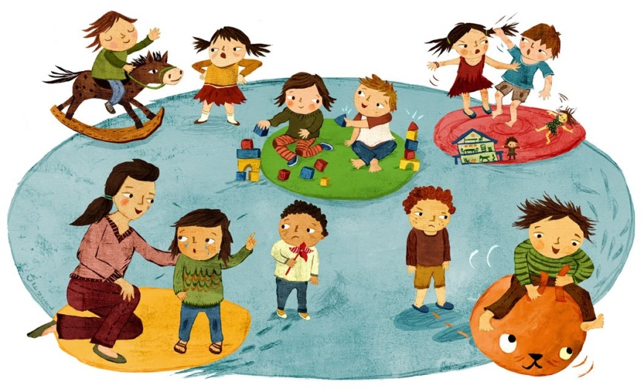
Within the EYFS there are 7 areas of Learning and Development:
Communication and Language
Physical Development
Personal, Social and Emotional Development
Literacy
Mathematics
Understanding the World
Expressive Arts and Design

Slide 5
Meet the teachers

Slide 6
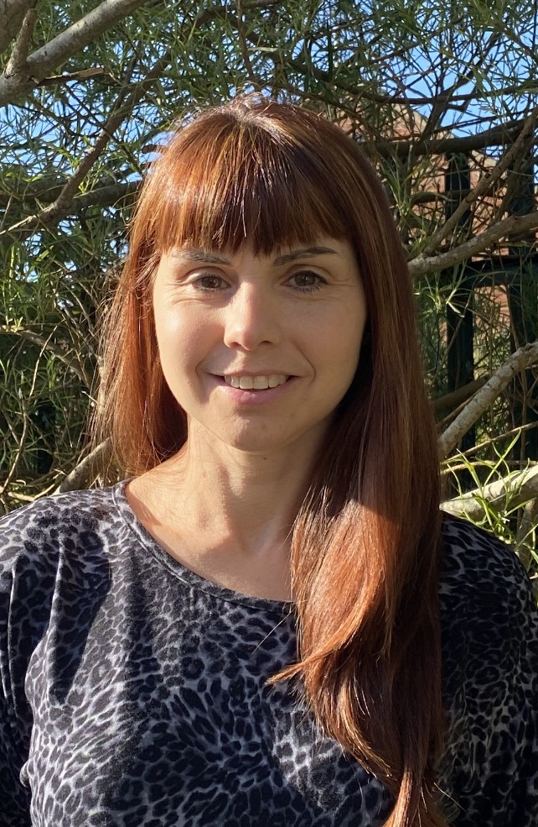
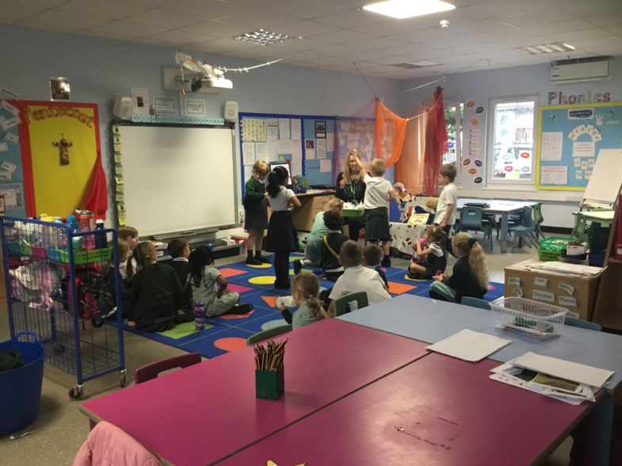
Foundation Stage set up…
We have 2 Home Bases;
Blue Base – Mr Balaam
(FS Leader)
Mrs Robbins (TA)

Slide 7
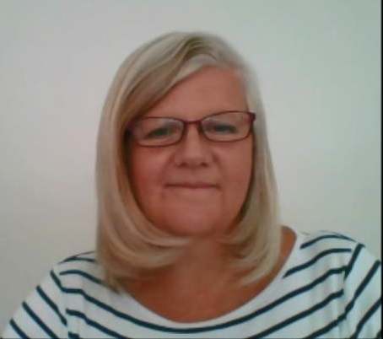
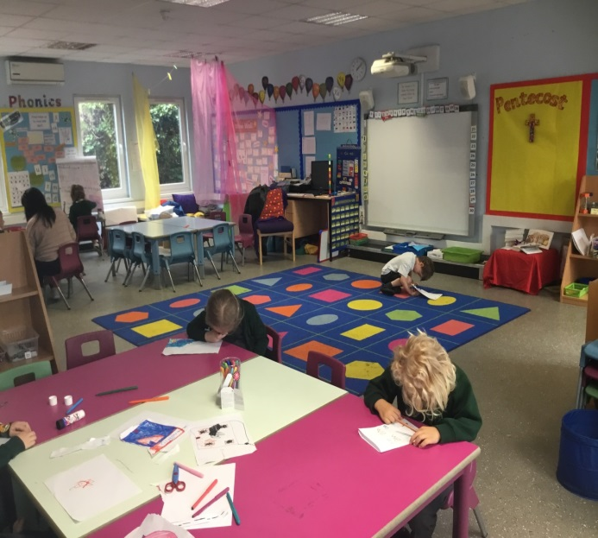
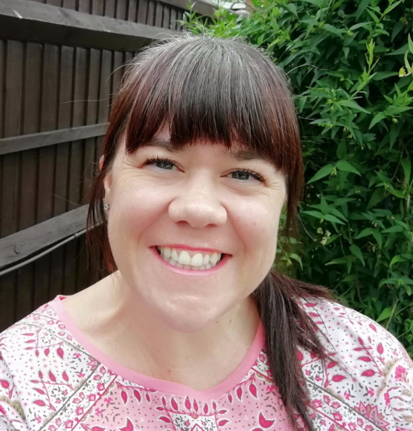
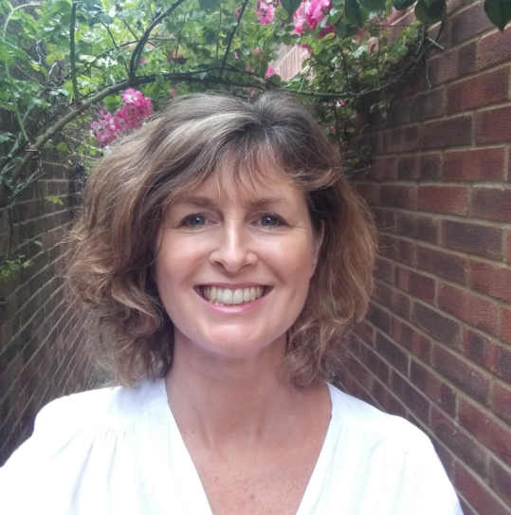
Foundation Stage set up…
Yellow Base – Miss Archer (Mon/Tues/Wed)
Mrs Conway (Thurs/Fri)
Mrs Cherry (TA)

Slide 8
Morning Activities
This is a very important time for your child, as it gives them time to settle, greet their teachers and their friends, choose what lunch they will be having and then start an activity that will support and enhance their learning
If your child is persistently late or has a poor attendance record, this is likely to have a significant negative effect on their progress
Provisional Times for September
8:45 a.m. - Fort Road gate will open
8:55 a.m. - Gate will close for children’s safety

Slide 9
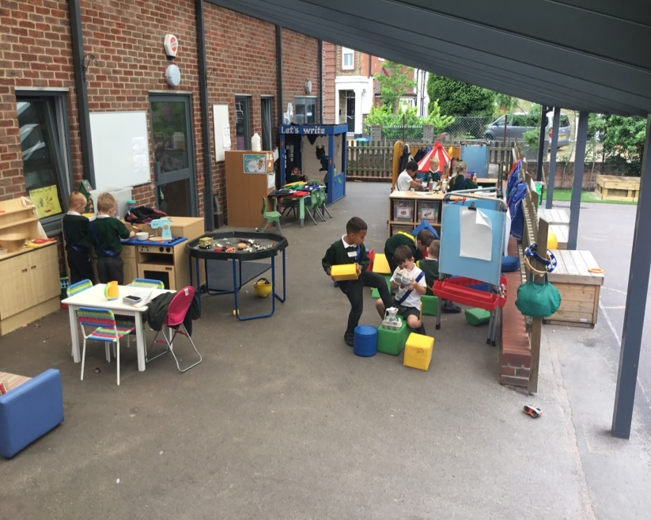
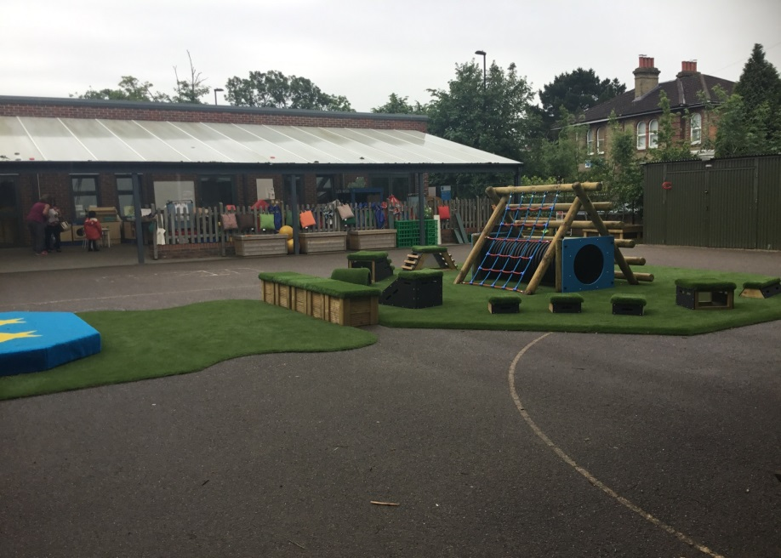
Discovery Time
During the school day, the children have ‘free-flow’ access to both bases and we organise a coloured band system for access to the Canopy and Outside areas. All teachers and teaching assistants have contact with all the children, at various times throughout the week.
Notes:
Your child will be allocated a base, by the end of the Summer Term and you will be notified by e-mail.

Slide 10
We like to pray and talk to God – together and sometimes on our own

Slide 11
This is the school hall – where you will eat your lunch and have P.E.

Slide 12
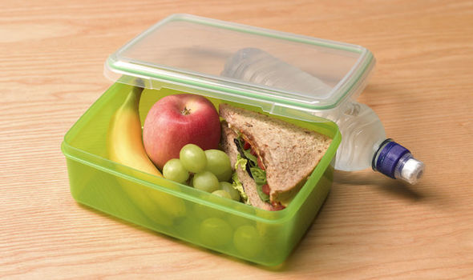
Lunches
Every child in Foundation Stage is entitled to a free school meal, until the end of Year 2
They can choose a school meal or bring a packed lunch from home (No nuts / nut based products)
There is a choice of a meat or a vegetarian option every day
You will be given a school lunch menu so that you can help your child to choose an option and details are on our school website; https://www.spcps.co.uk/school-lunches

Slide 13
Where do I go on my first day?

Slide 14
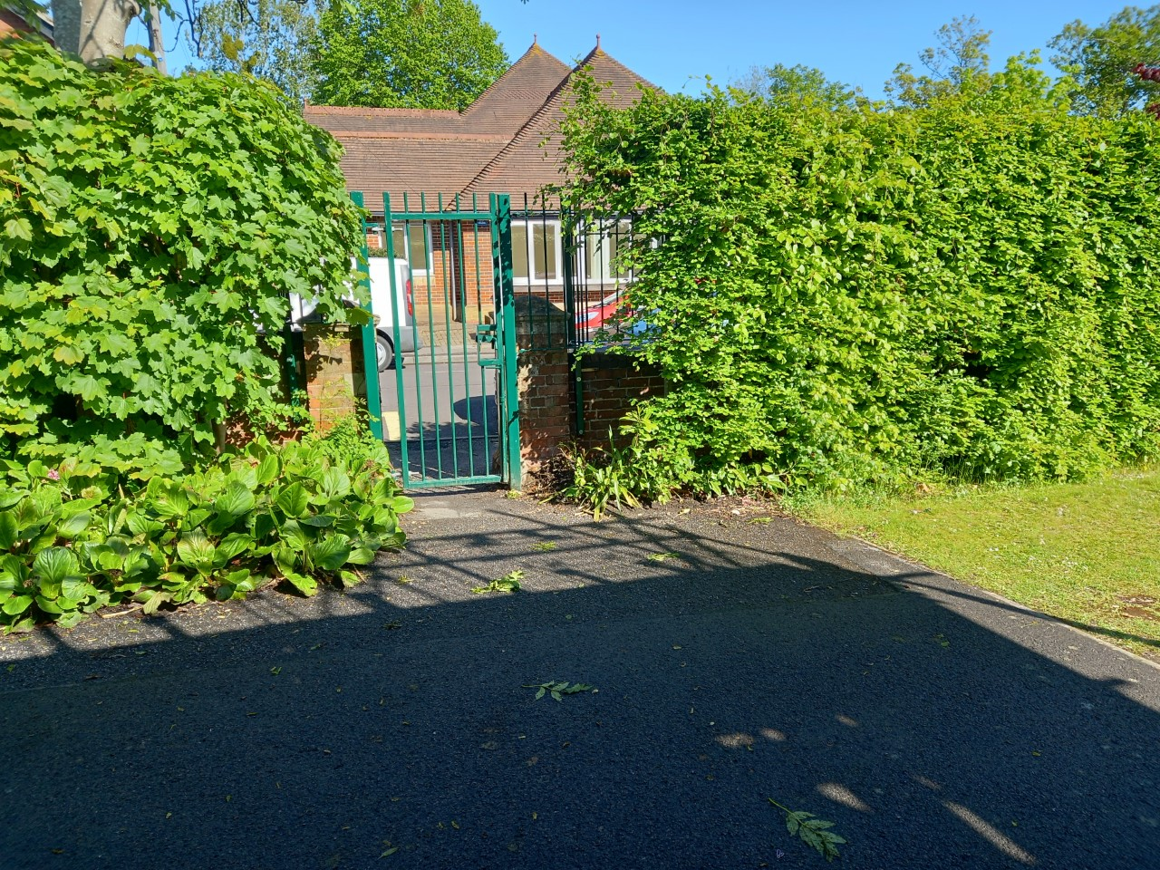
Enter via the Fort Road gate that leads through to Foundation Stage canopy

Slide 15
What will I wear at school?

Slide 16
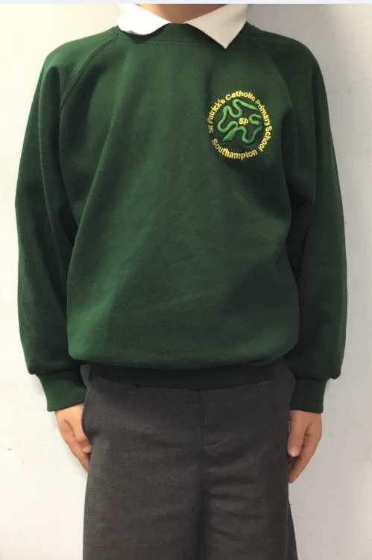
School Uniform
All clothing must be labelled with
your child’s name.
White polo shirt
Green school jumper / cardigan
Dark grey tracksuit bottoms / leggings
Black plimsolls or smart black trainers
(No laces)
PE Kit – Summer term only
Green T-shirt
Black shorts or black tracksuit bottoms / leggings
Black trainers / plimsolls (No laces)
The nearest school uniform shop is “Wearabouts”, Victoria Road, Woolston or Tesco provides an ordering service. Also, other parents have used;
https://myclothing.com/st-patricks-catholic-primary-school/7583.school

Slide 17
What can you do to prepare for school?

Slide 18
Getting your child ready for school
over the Summer holidays
‘School Readiness’
Independent toilet routine
Put on their coat / jumper and take it off
Try on their uniform
Recognise and talk about numbers, letters and shapes in the environment, e.g. bus numbers, road signs, windows on houses
Practise counting to 10 in English
To recognise their own name
To write their own name
Use a knife and fork and attempt to cut their own food

Slide 19
Getting your child ready for school
over the Summer holidays
‘School readiness’
Read lots of stories to your child
When your child is writing their name, use lower case letters (except for the capital letter at the beginning)
JOHN jOhN john John
All children’s items to be labelled,
including hats, scarves and gloves

Slide 20
Pupil Premium
The Pupil Premium Grant (PPG) is extra government funding given to schools to support children with their learning.
For the school to qualify for PPG, you need to be in receipt of one of the following:
Income Support
Income-based Jobseekers Allowance
Income-related Employment and Support Allowance
Support under Part VI of the Immigration and Asylum Act 1999
The guaranteed element of State Pension Credit
Child tax credit with an annual gross income into the household that is no more than £16,480, provided you are not entitled to working tax credit. If you are entitled to any part of working tax credit there is no eligibility with the exception of working tax run-on as shown below
Working Tax Credit run-on - paid for 4 weeks after you stop qualifying for Working Tax Credit
Universal Credit

Slide 21
Pupil Premium
The funding can be used for:
Extra support and 1:1 tuition
Challenge and support interventions
Financial support with uniform costs, music lessons, clubs and visits
If you think you qualify, please register on-line by clicking;
https://www.cloudforedu.org.uk/ofsm/southampton
If you would like help or more information,
please contact the school office.

Slide 22
My first week…

Slide 23
My first week:
Monday 13th September – Friday 17th September
If your child was born between September – February, they will be in school in the morning, from 9:00 until 12:00. This will include a school lunch. They will come into school via the Fort Road gate. The Foundation team will be ready to meet you. You will be able to pick up your child from the Fort Road gate.
If your child was born between March – August, they will be in school after lunch, from 1:00 – 2:50. They will come into school via the Fort Road gate, where a member of the Foundation team will be ready to meet you.

Slide 24
My second week:
Monday 20th September – Friday 24th September
All children in full-time.
The Foundation teachers will be waiting at the Fort Road gate to welcome your child as they start school.
This is an important time for your child and it is important that their start at school is a positive experience.

Slide 25
We look forward to seeing you very soon!

Slide 26
Question Time

